Slide 1
IBM University Engagement Project Submission
“Exploring the Power of Agentic AI with IBM Cloud and Orchestrate”

Slide 2

Project Tile – [Apex Finance Agent – Sequential Task Agent: Investment Analyst.]
Domain of Project – [Finance Technology (FinTech)]
Student Name | Recent Passport Photo | Email ID | Mobile number [WhatsApp]
Krishna Shivaling Chougule |  | krishnachougule963@gmail.com | 9834967781
Recommended font style and size: Font Style: Arial Font Size (Heading): 28
Font Size (Content): 20

Slide 3
Problem Statement -
Problem Statement 04:Apex Finance Agent – Sequential Task Agent: Investment Analyst.
Investors often struggle to make informed financial decisions due to the overwhelming amount of market data, financial reports, news articles, and rapidly changing market conditions. Manually collecting, analyzing, and interpreting this information is time-consuming and requires significant financial expertise. As a result, many investors may overlook critical insights, leading to increased investment risks and less informed decisions.
Apex Finance Agent addresses this challenge by acting as an AI-powered Sequential Task Agent that automates the investment analysis process. It systematically gathers financial data, analyzes company performance, evaluates market trends, identifies potential risks, and generates clear, data-driven investment insights. By performing these tasks in a structured sequence, the agent provides users with reliable, transparent, and easy-to-understand recommendations, enabling smarter and more confident investment decisions.
Objective
To develop an intelligent AI-powered investment assistant that automates financial analysis, simplifies complex financial information, and delivers accurate, data-driven recommendations through a structured sequential workflow.
Key Challenges Addressed
Automating financial data collection from multiple sources.
Analyzing company performance and financial statements.
Identifying market trends and investment risks.
Reducing the time required for investment research.
Providing clear, unbiased, and actionable investment recommendations.
Supporting investors with informed and data-driven decision-making.

Slide 4
Proposed Solution -
Proposed Solution: AI-Powered Apex Finance Agent
Apex Finance Agent is an AI-powered Sequential Task Agent designed to automate the investment analysis process. Instead of manually collecting and evaluating financial information, the agent performs a series of structured tasks to deliver accurate, transparent, and data-driven investment insights.
The agent begins by gathering financial data, stock prices, company reports, and market news from trusted sources. It then validates the collected information, analyzes key financial metrics and market trends, evaluates potential investment risks, and generates intelligent recommendations. Finally, it presents the results through clear summaries, reports, and interactive dashboards, enabling users to make informed investment decisions with confidence.
Sequential Workflow
Data Collection – Gather financial data, stock prices, company reports, and market news.
Data Validation – Verify the accuracy and reliability of the collected information.
Financial Analysis – Evaluate company performance using financial statements and key performance indicators (KPIs).
Market Trend Analysis – Analyze market movements and industry trends.
Risk Assessment – Identify potential investment risks and opportunities.
Recommendation Generation – Provide AI-powered, data-driven investment suggestions.
Report & Dashboard – Present findings through easy-to-understand reports and visual dashboards.
Key Features
AI-powered sequential task execution.
Automated financial data collection and analysis.
Market trend and sentiment analysis.
Investment risk evaluation.
Personalized investment recommendations.
Interactive reports and dashboards.
Fast, accurate, and transparent decision support.

Slide 5
Technology Used
1. Artificial Intelligence & Machine Learning
AI Agents – Used to automate sequential investment analysis tasks.
Large Language Models (LLMs) – Used for financial reasoning, report generation, and intelligent recommendations.
Machine Learning Algorithms – Used for market trend analysis, prediction, and risk assessment.
Natural Language Processing (NLP) – Used to analyze financial news, reports, and market sentiment.
2. AI Agent Framework
IBM watsonx.ai / IBM Granite Models – Used for building intelligent AI-powered financial analysis and decision-making capabilities.
Langflow – Used to design and manage AI agent workflows and sequential task execution.
Agent Orchestration – Used to coordinate multiple analysis steps such as data collection, validation, evaluation, and reporting.
3. Frontend Technologies
HTML5 – Used for creating the structure of the web application.
CSS3 – Used for designing a responsive and modern user interface with animations and dashboards.
JavaScript – Used for interactive features, dynamic content, and user interactions.
4. Backend Technologies
Python – Used for AI logic, data processing, and backend development.
FastAPI / Flask – Used for creating APIs and connecting the AI agent with the frontend.
REST APIs – Used for communication between different application components.
5. Data & Financial Analysis Tools
Financial APIs – Used to collect stock prices, company information, and market data.
Data Processing Libraries
Pandas – Data manipulation and analysis.
NumPy – Numerical computations.
Matplotlib / Plotly – Data visualization and financial charts.

Slide 6
Orchestrate component Used -
1) Chat Input – Interface where users enter their queries, preferences, or meal details (text/voice/image).
2) IBM watsonx AI Agent - Processes user input using Granite models to generate personalized nutrition insights and recommendations.
3) Name of IBM Granite model - Granite-4.0-8B-Instruct → Fast, efficient for real-time diet recommendations
4) Chat output -Displays AI-generated responses such as diet plans, nutritional analysis, and health suggestions.
5) File component - Stores and retrieves user data, meal logs, and nutritional datasets for analysis and tracking.
6) Add name of any other component used.

Slide 7
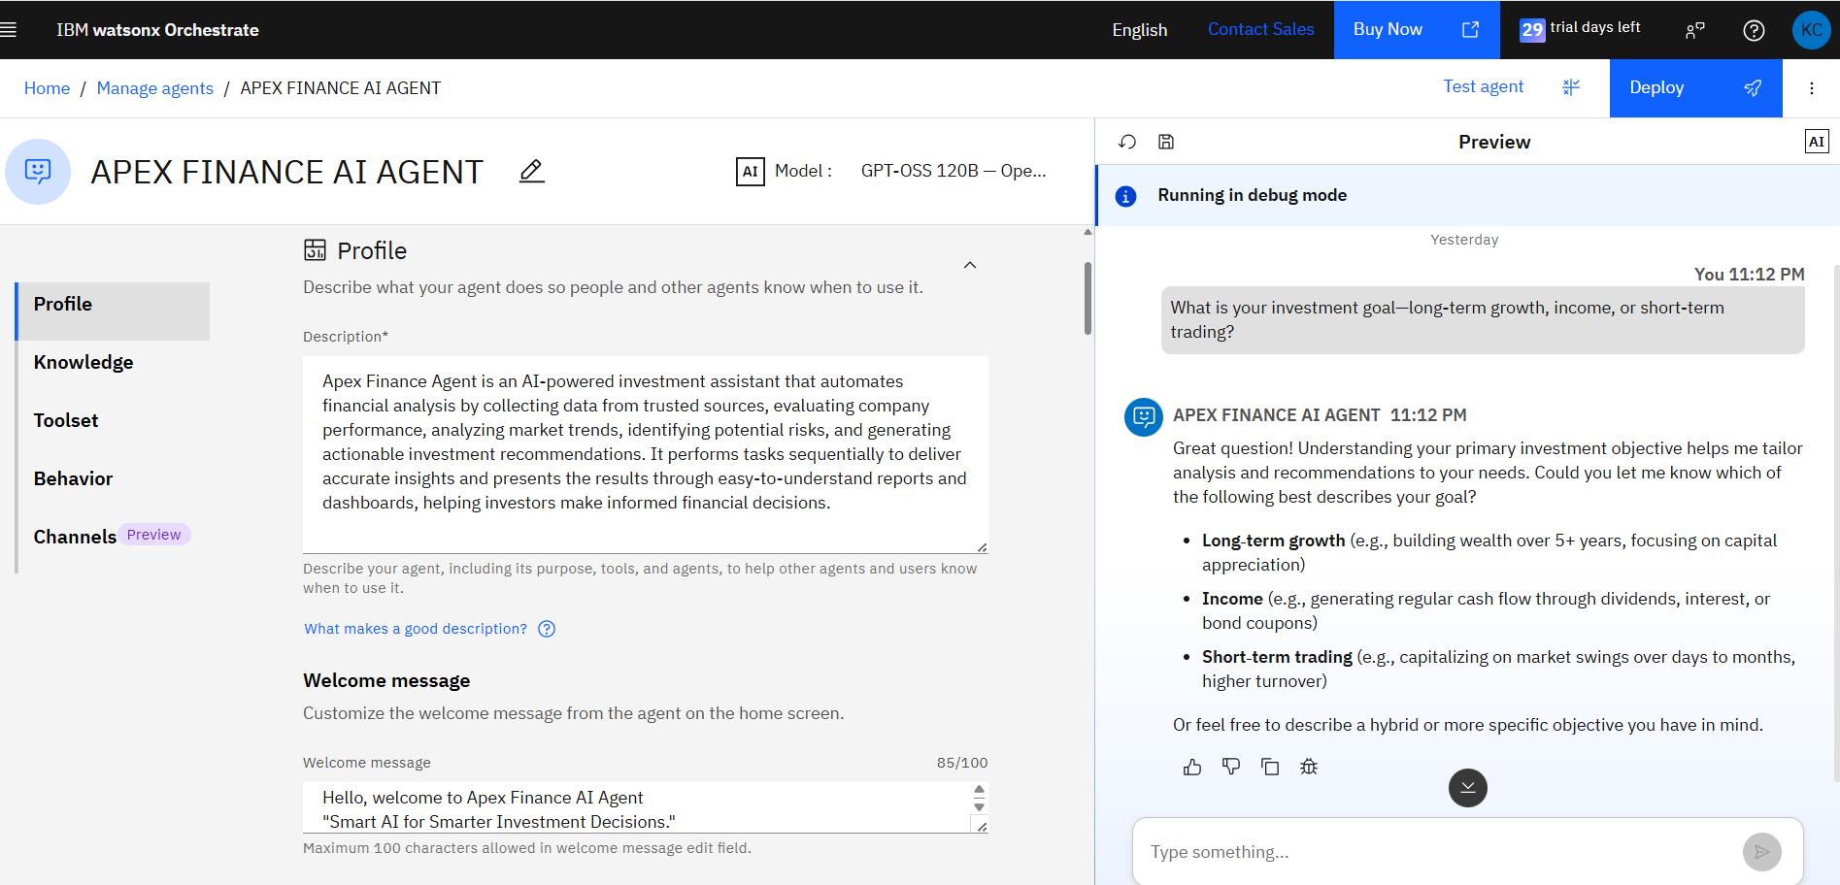
Agent Instructions Screenshot-

Slide 8
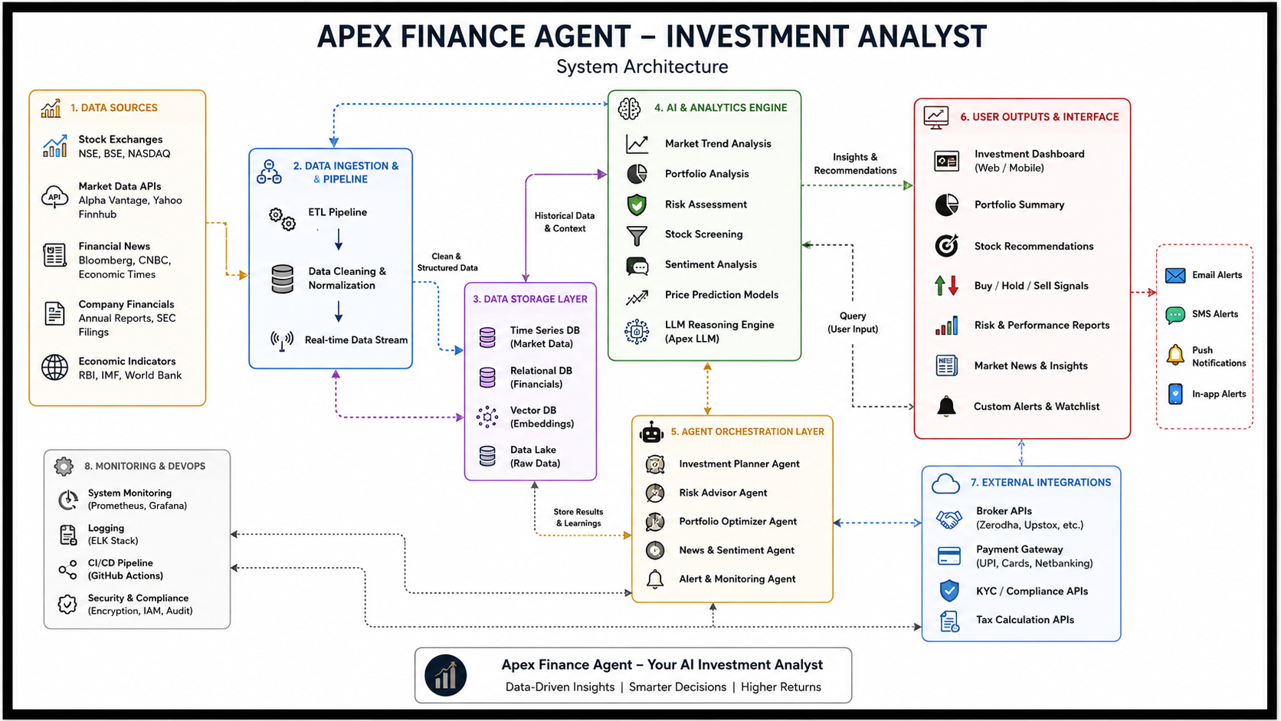
Orchestrate architecture blueprint

Slide 9
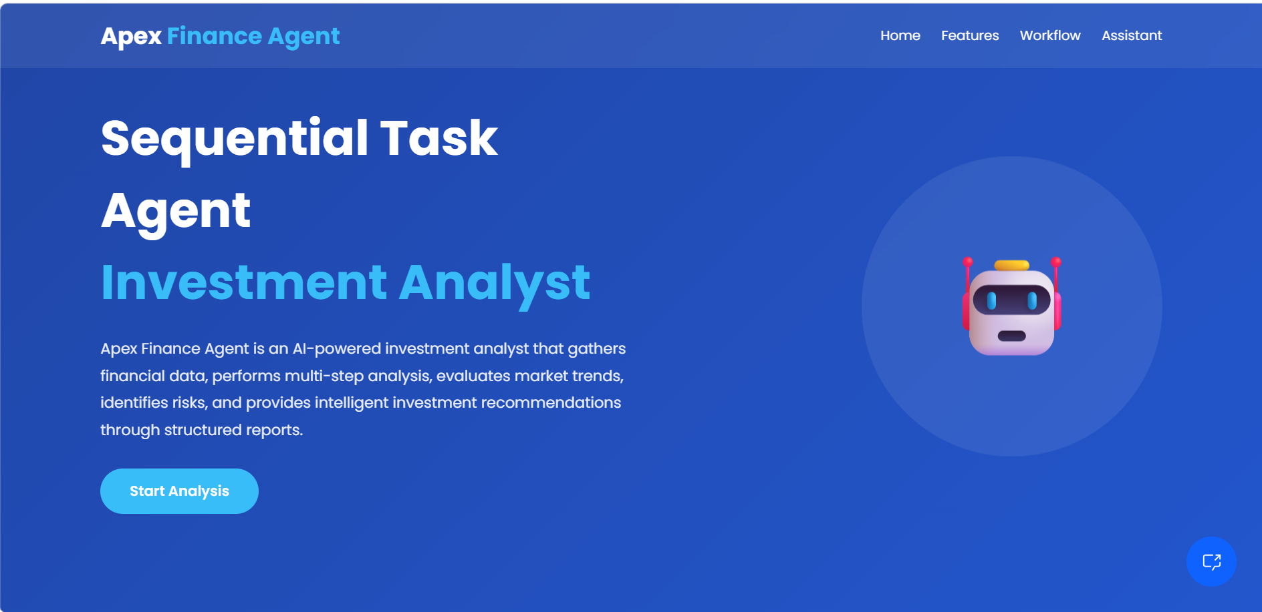
HOME PAGE:

Slide 10

Role of Agentic AI in the solution
Agentic AI plays a central role in Apex Finance Agent by enabling the system to independently perform complex investment analysis tasks through an intelligent, goal-oriented workflow. Instead of only responding to user queries, the AI agent can plan, execute, analyze, and generate insights by completing multiple tasks in a sequential manner.
Role of Agentic AI
1. Autonomous Data Collection
The AI agent automatically gathers financial information such as stock prices, company reports, market news, and economic indicators from available data sources.
Reduces the need for manual research and improves analysis speed.
2. Intelligent Task Planning & Execution
Agentic AI breaks down investment analysis into multiple steps:
Collect data
Validate information
Analyze financial performance
Evaluate market trends
Assess risks
Generate recommendations
Executes these tasks in the correct sequence to produce meaningful results.
3. Financial Data Analysis
The agent analyzes financial statements, company growth, profitability, valuation metrics, and market behavior.
Identifies important patterns and trends that may influence investment decisions.
.

Slide 11
Novelty and Uniqueness
Apex Finance Agent is an AI-powered investment analyst that goes beyond traditional stock screening and portfolio tracking. It combines real-time market intelligence, generative AI, and autonomous agent technology to provide personalized, explainable, and actionable investment insights.
Key Unique Features
Multi-Agent AI Architecture
Separate AI agents for market analysis, portfolio optimization, risk assessment, sentiment analysis, and financial planning.
Agents collaborate to generate accurate investment recommendations.
Personalized Investment Strategy
Learns user goals, risk appetite, investment horizon, and financial behavior.
Creates customized portfolios instead of generic recommendations.
Explainable AI
Every Buy, Hold, or Sell recommendation includes the reasoning behind the decision.
Improves transparency and user trust.
Real-Time Market Intelligence
Continuously monitors stock markets, news, earnings reports, economic indicators, and global events.
Updates recommendations instantly based on changing market conditions.
AI-Powered Sentiment Analysis
Uses NLP to analyze financial news, social media, analyst reports, and company announcements.
Detects positive or negative market sentiment before major price movements.

Slide 12
Git Hub Link
Please test and Paste the working Github URL – https://github.com/krishnachougule963/IBM-BOOT-CAMP.git
Make sure you have Uploaded following three files into your github repository 1) app.json file
2) yourproblemstatement.pdf file
3) your projectpresntation.pptx file
·
·
·

Slide 13
Future Scope
1. AI Financial Advisor
Develop a fully autonomous AI advisor that provides personalized investment strategies, retirement planning, tax-saving suggestions, and wealth management.
2. Global Market Integration
Expand support to international stock markets such as NYSE, NASDAQ, LSE, Nikkei, and cryptocurrency exchanges for global investment opportunities.
3. Robo-Advisory Services
Enable automatic portfolio creation, asset allocation, and portfolio rebalancing based on users' financial goals and risk profiles.
4. Voice-Based AI Assistant
Integrate voice assistants so users can ask investment-related questions using natural speech and receive real-time financial advice.
5. Advanced Predictive Analytics
Use deep learning models to forecast stock prices, market trends, volatility, and investment risks with higher accuracy.
6. Blockchain Integration
Leverage blockchain technology for secure transaction records, smart contracts, and transparent investment tracking.
·
·
·

Slide 14
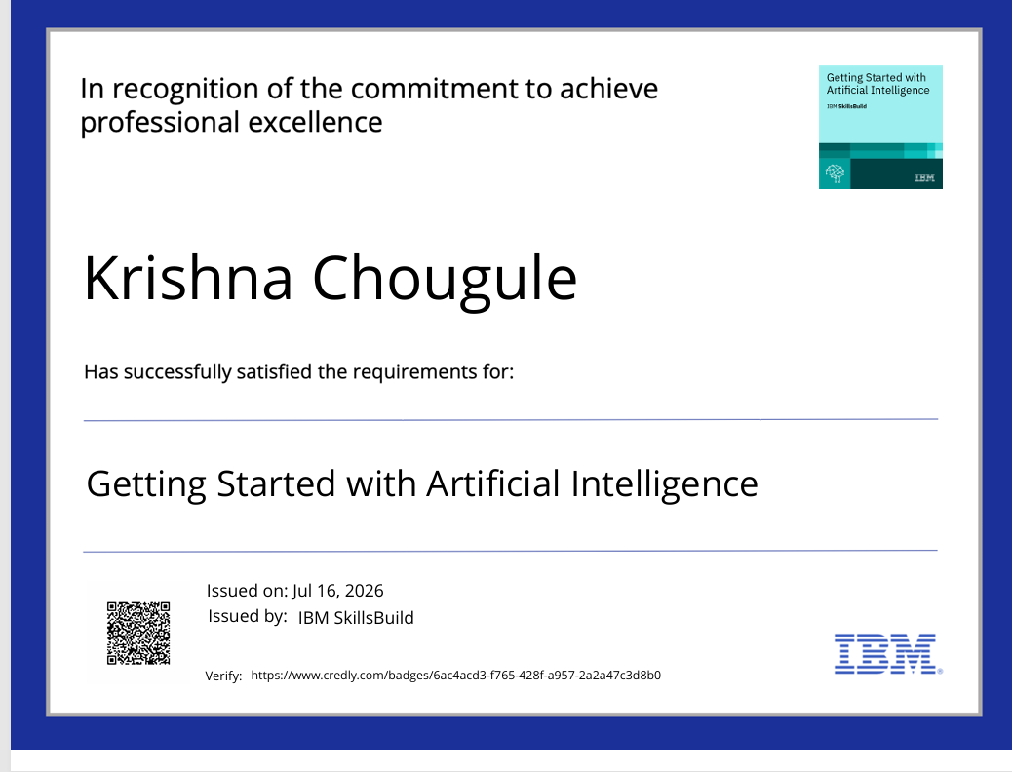
Certificates Earned:

Slide 15
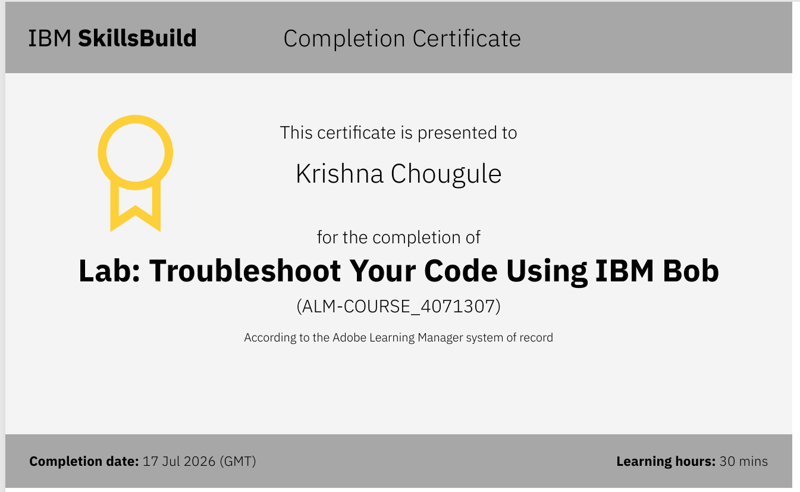
Certificates Earned:​

Slide 16


